Slide 1
DATA ANALAYSIS AND VISUALIZATION
MINI PROJECT
Review-1

Slide 2
Analysis on Suicide Etiology

Slide 3
Team Members
Names | Roll No
Hitesh D | 20211IST0023
Shamitha R | 20211IST0020
Sushmitha V M | 20211IST0026

Slide 4
Introduction
Suicide remains a complex and multifaceted phenomenon with devastating consequences for individuals, families, and communities worldwide.
More than 700 000 people die due to suicide every year.
Suicide is the fourth leading cause of death among 15–29-year-olds.
Seventy-seven per cent of global suicides occur in low- and middle-income countries.

Slide 5
Tools used:
Software:
Google Collab
Libraries:
NumPy
Pandas
Seaborn
Matplotlib
Dataset: Suicide rate in India

Slide 6
Methodologies
Download the Dataset
Data Preparation
Data Cleaning
Removing Null values
Replacing the values
Exploratory Analysis and Visualization

Slide 7
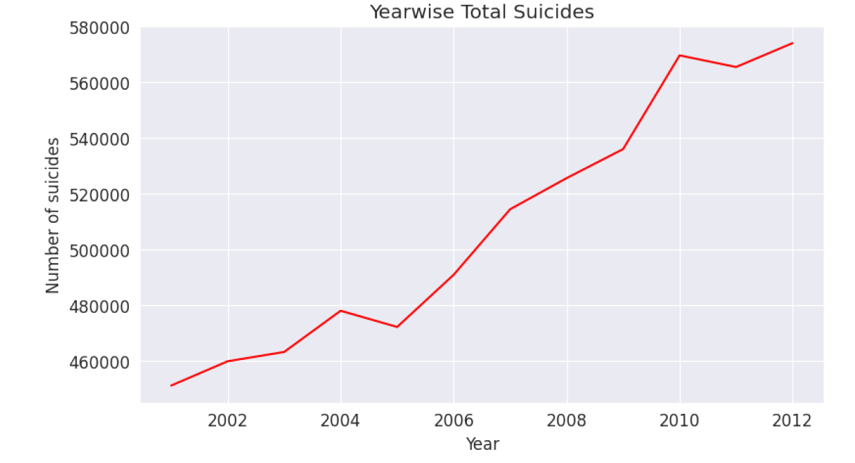
Outcomes:

Slide 8
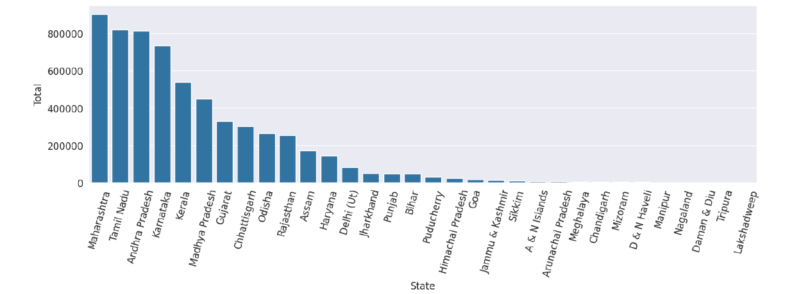

Slide 9
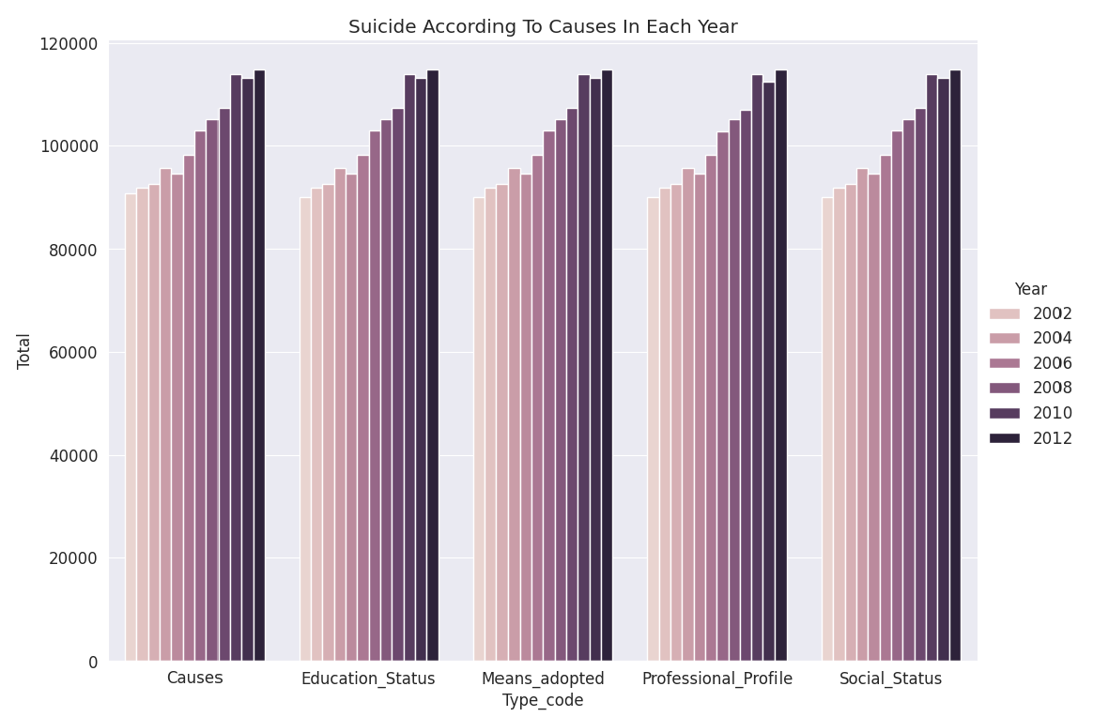

Slide 10
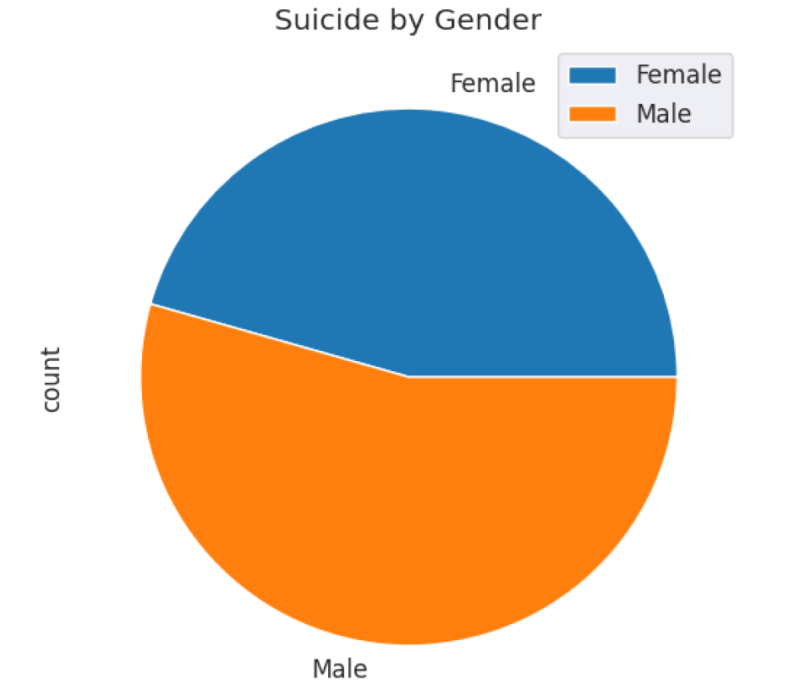

Slide 11
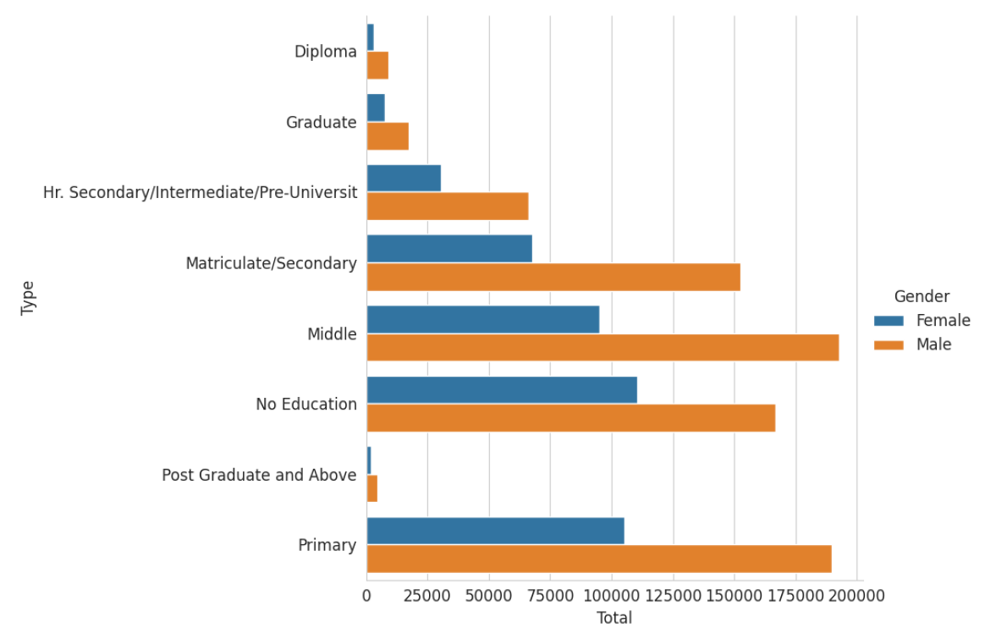

Slide 12
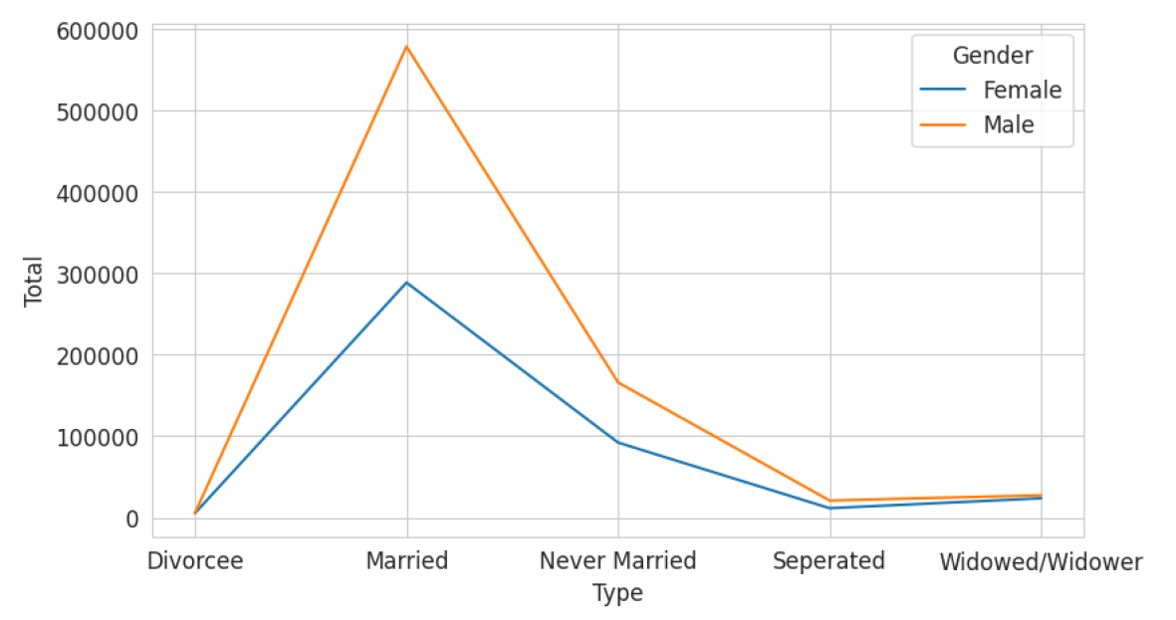

Slide 13
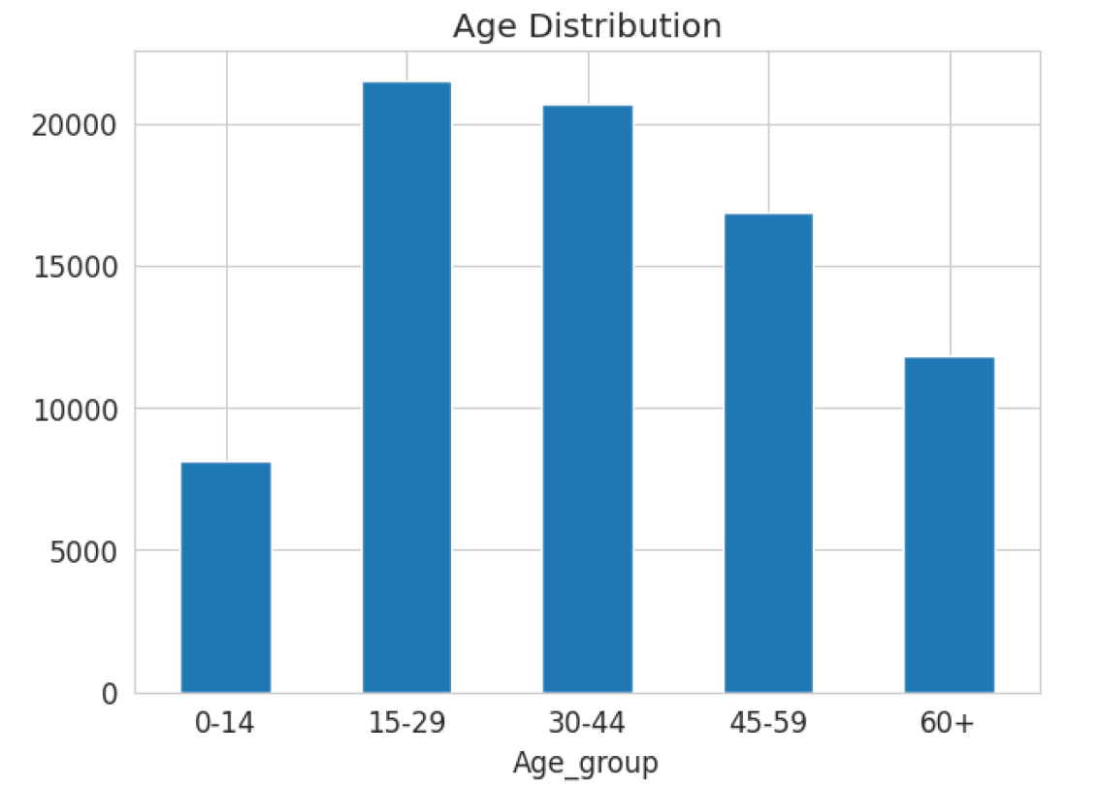

Slide 14
Limitations and Future Scope
The inference of the insights found has not been implemented.
All kinds of charts are not used to visualize the data
The data of suicide rates is like real-time data ,so analysis results need to be performed regularly.

Slide 15
CONCLUSION
In this project, we achieved a cleaned dataset of the Suicide etiology data which can be used for visualization.
We discovered :
the state which has maximum Suicide rates
the year recorded highest suicide rate
the different causes for suicide
the main causes for suicide
Comparing gender which recorded highest suicide rate
the Suicide rate cause –wise
the number of suicides that happened each year.

Slide 16
Thank You

